Slide 1

Mental Health at Workplace
DSCI 6007 – Final Project

Slide 2

OUR TEAM
Venkata Susmitha
Rohith
Akhila Immanni
Mahesh
Data Analyst
Data Engineer
Data Scientist
Data Visualization
Github link: https://github.com/VDUGG2/DIistributed

Slide 3

INTRODUCTION
In this Project, we will try to understand the factors that are contributing to the mental health of a person.
The dataset used in this project is from Kaggle which is extracted from a 2014 survey that measures attitudes toward mental health and the frequency of mental health disorders in the workplace.
From this project, we get to understand mental health in the workplace in a systematic manner.
All the files are stored in this Github Repository.

Slide 4

Methods
Topics in CRISP-DM Method (Cross Industry Standard Process)
Iteration 1:
The process involved during the first iteration are:
1. Business Understanding
2. Data Understanding
3. Data Preparation
4. Modeling
5. Evaluation and
6. Deployment

Slide 5

Iteration 2: Goal Redefinition 1. Data Understanding 2. Modeling and Evaluation Iteration 3: Variable and Instance Selection

Slide 6

Challenges
How to handle mental health at the workplace ?
Mental Health affects mental, psychological, and social well-being. It also affects how we think, feel and act. It also helps us in determining how we handle stress by relating it to others. The impact of mental health on an organization can mean a lot of things: an increase in absent days from work, Decrease in productivity. In the US, approximately 70 percent of adults with depression are in the workforce. Employees with depression will miss a lot of days.

Slide 7
Solution
This problem can be solved using Mental Health First Aid. It helps participants to notice and support individuals who are suffering from mental health. It teaches employees communication and support skills which can help people suffering from mental health. Research shows that employees who used first aid have increased awareness of mental health among themselves and their co-workers. It allows them to recognize the signs of someone who is struggling with mental health and teaches them the skills to when and where to reach out.

Slide 8
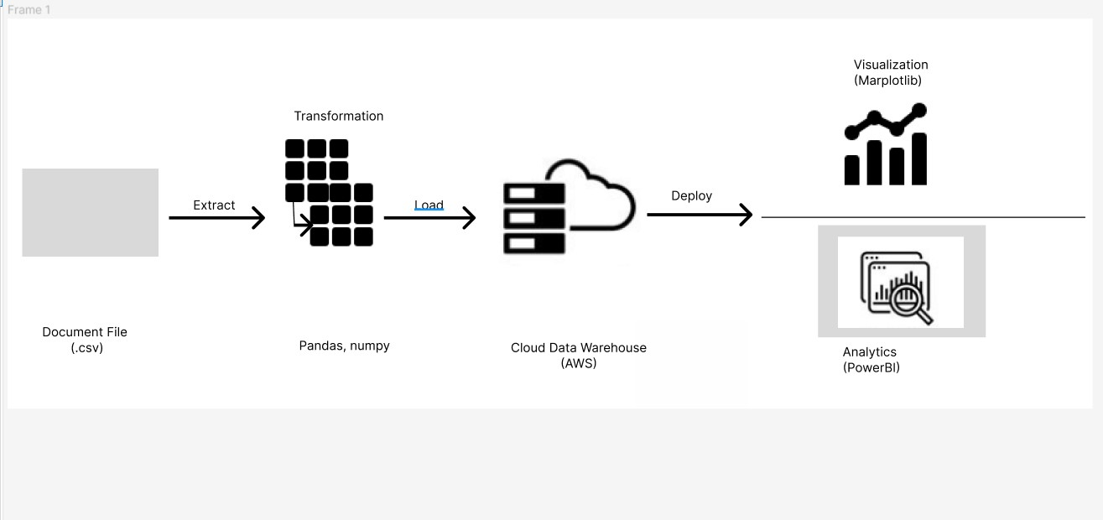
Graphical View of ETL Tools :

Slide 9


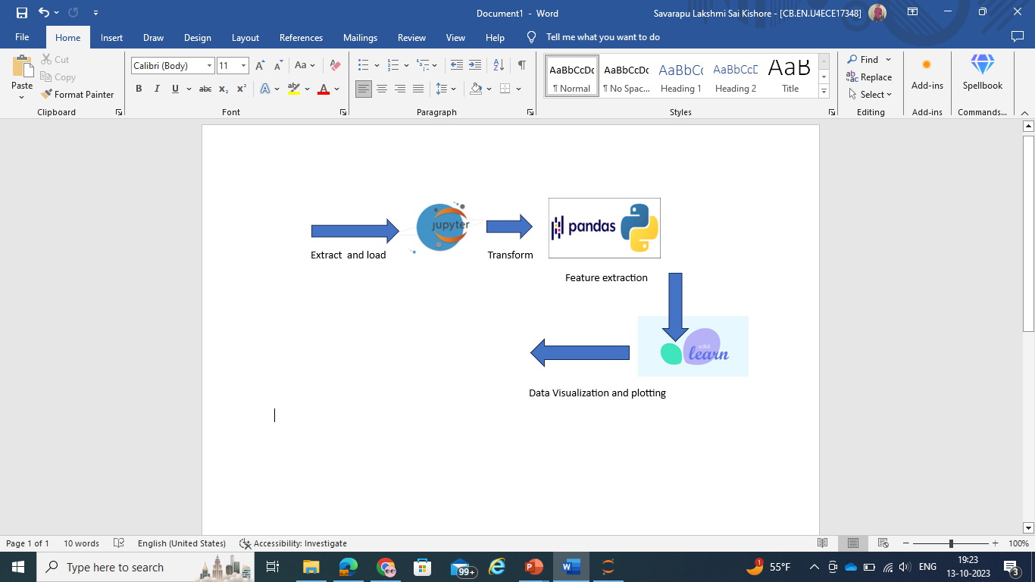

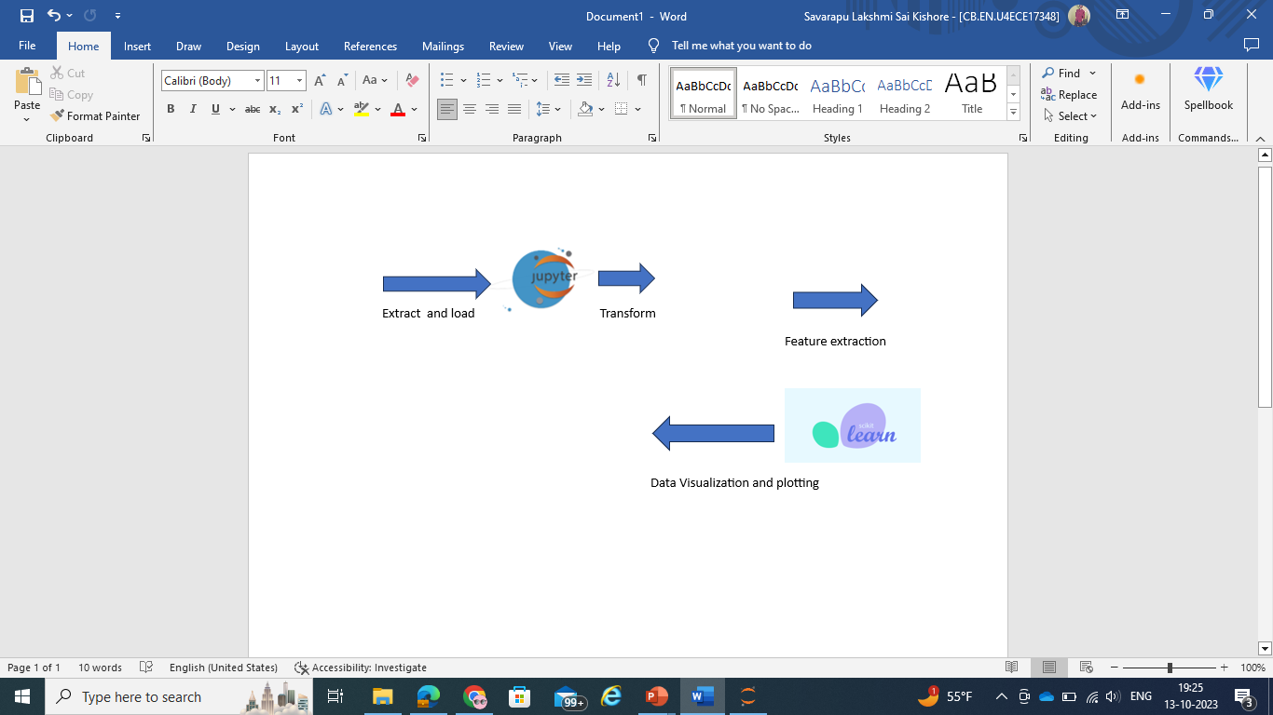

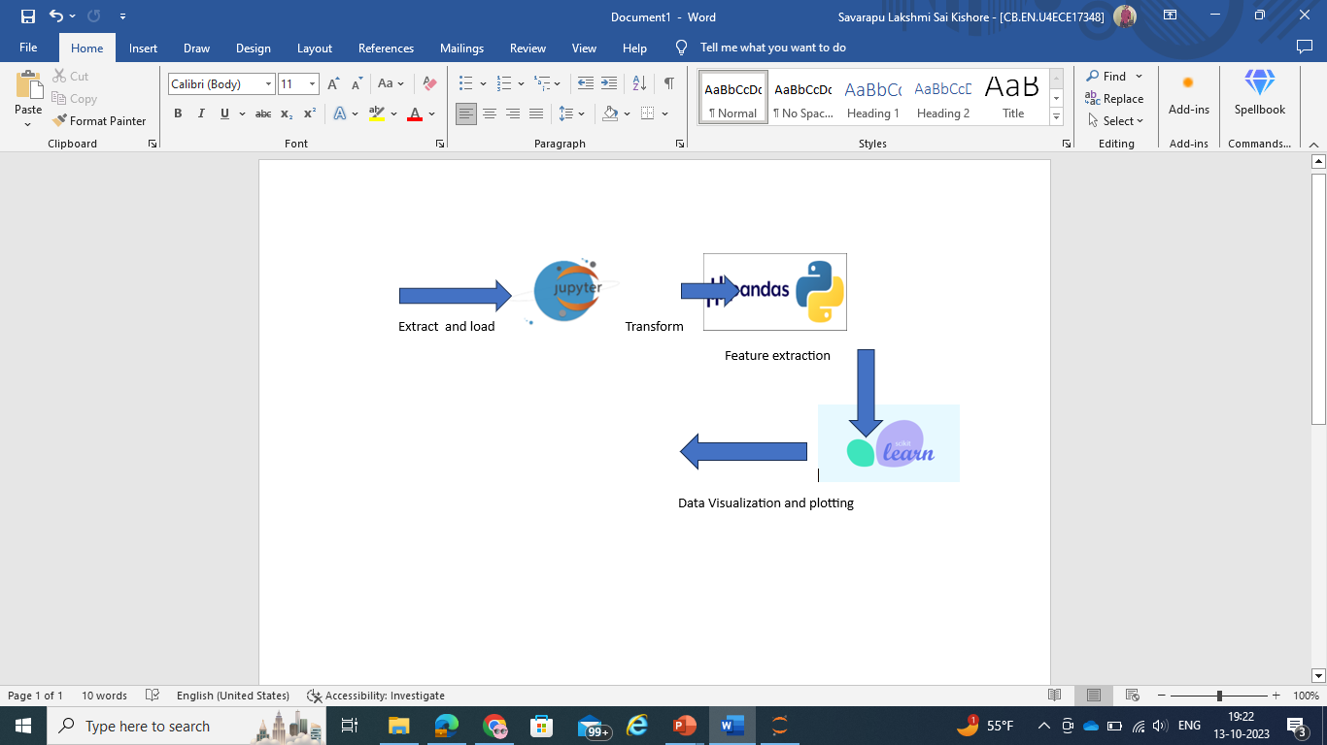
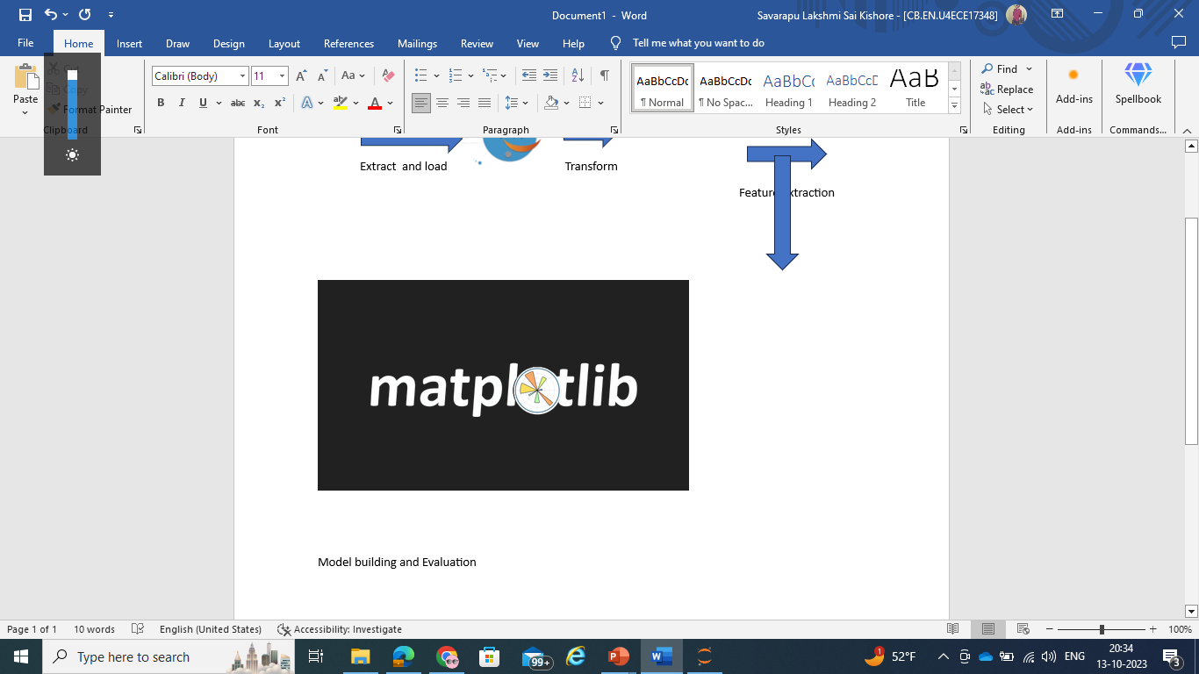

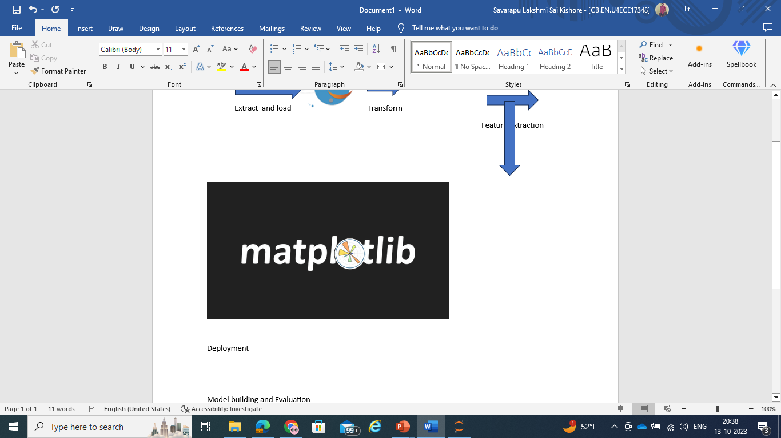


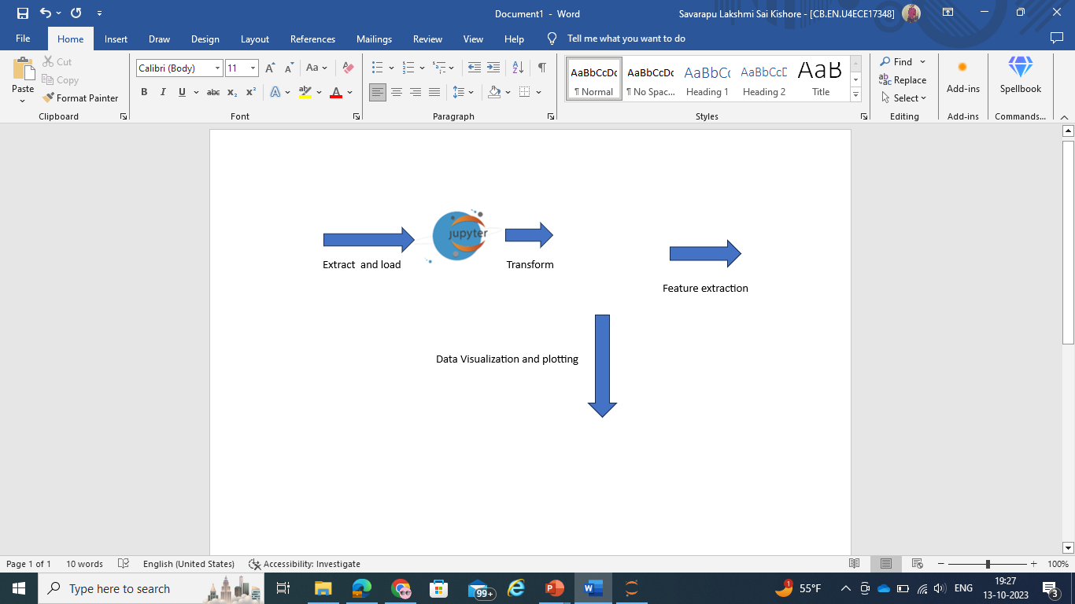
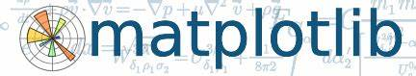
GRAPHICAL VIEW OF THE PROPOSED MODEL

Slide 10
Dataset
There are a total of 26 columns in the dataset.
We see that except the age column, all the columns are of object datatype.
Comment column seems to contain most number ( 70% ) of null values, which makes sense because it was an optional text box so it's reasonable to expect that many (most) respondents would leave it blank.
We will be dropping the timestamp column because it's contains date, month, year and time the respondent took this questionnaire, which is irrelevant for us. The state column also contains a lot of null values. We'll dig deeper into that

Slide 11
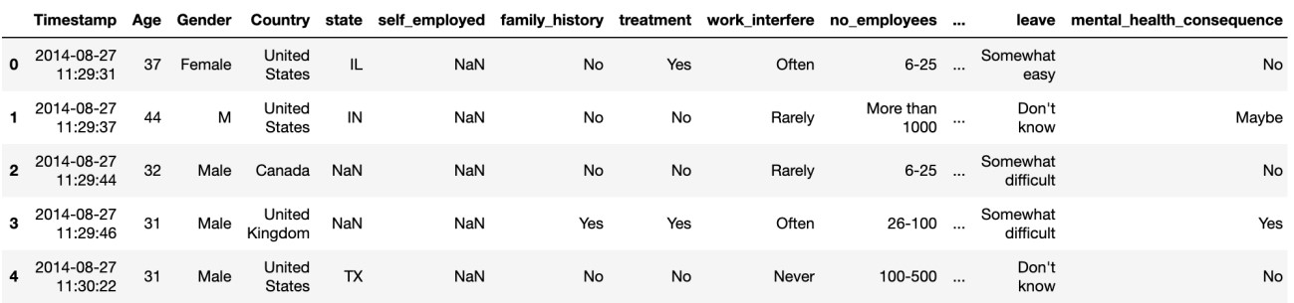
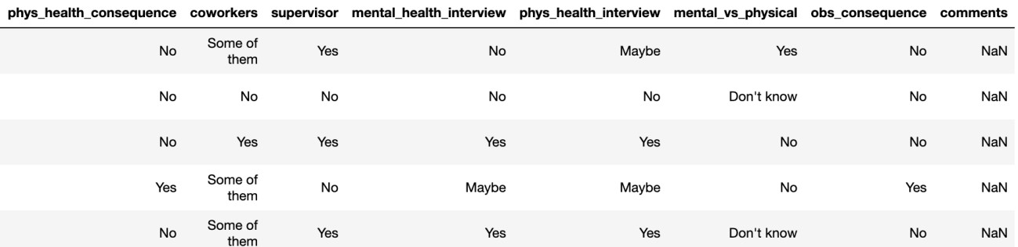

Slide 12
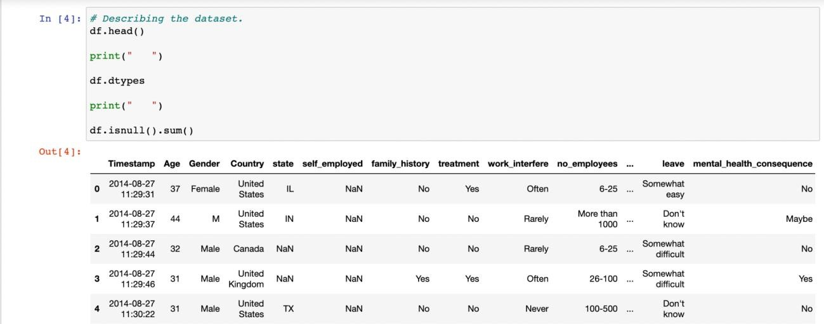
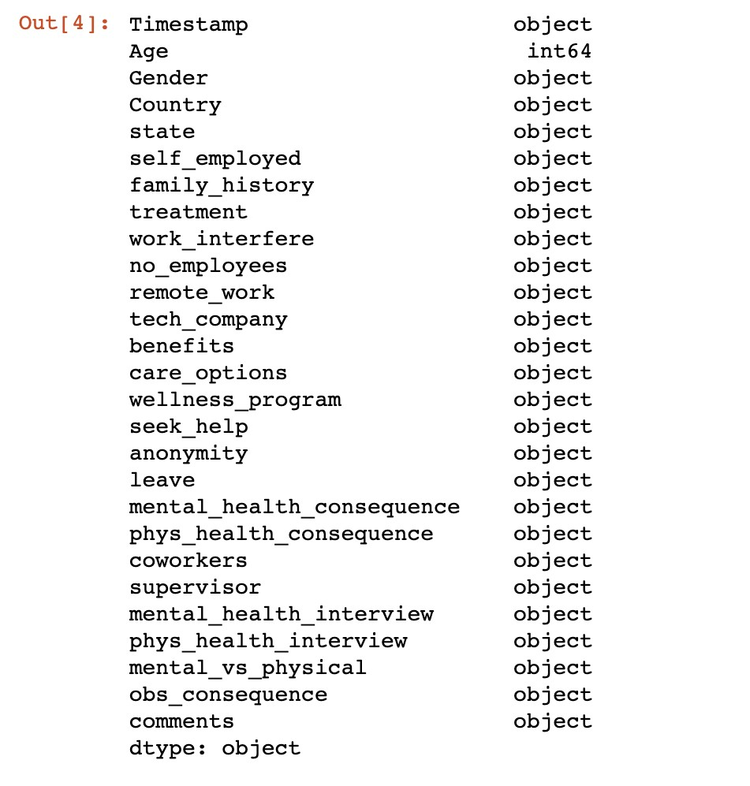

Slide 13
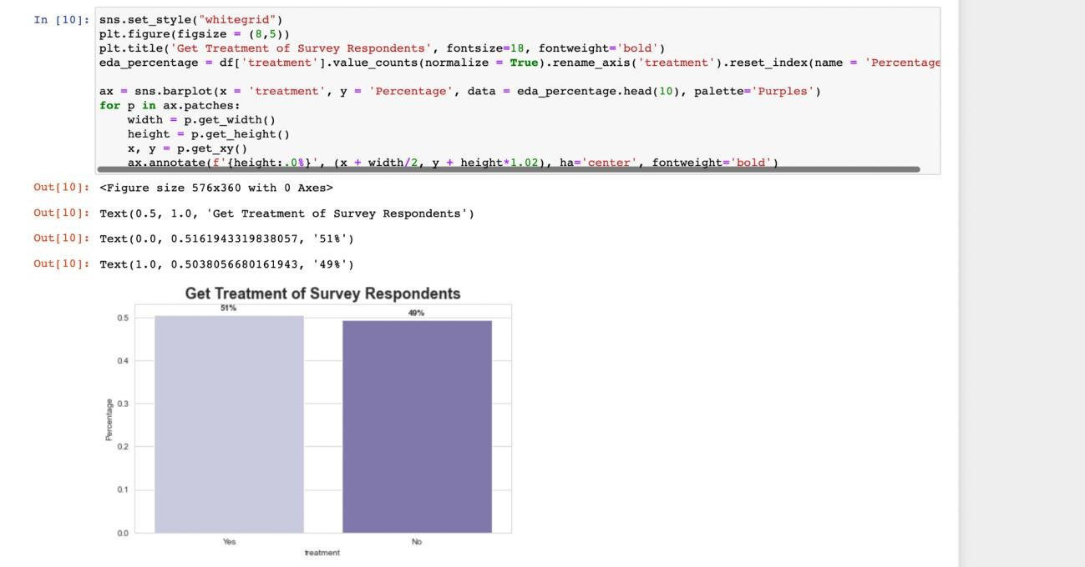
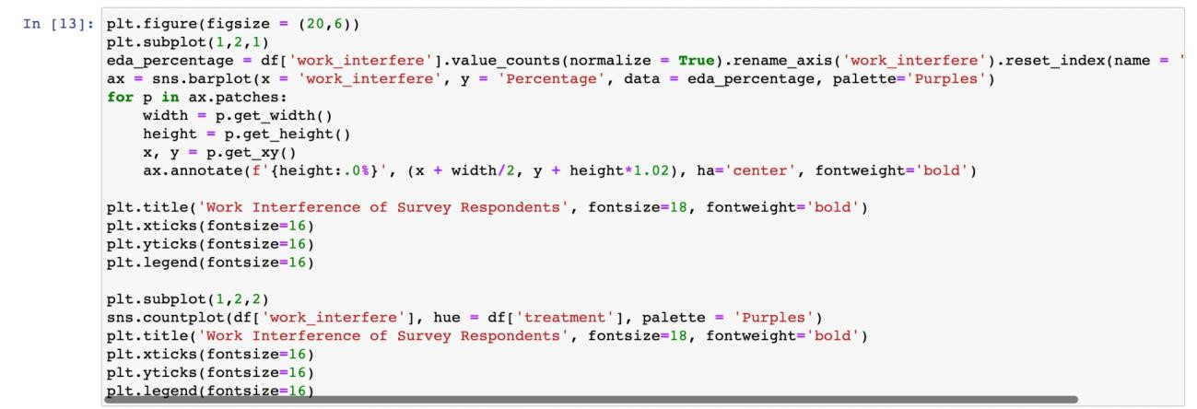
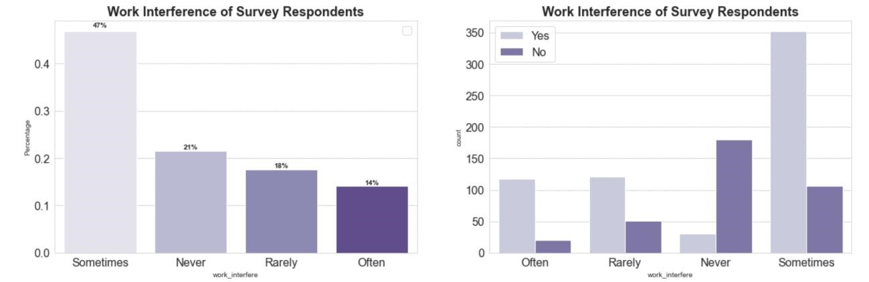
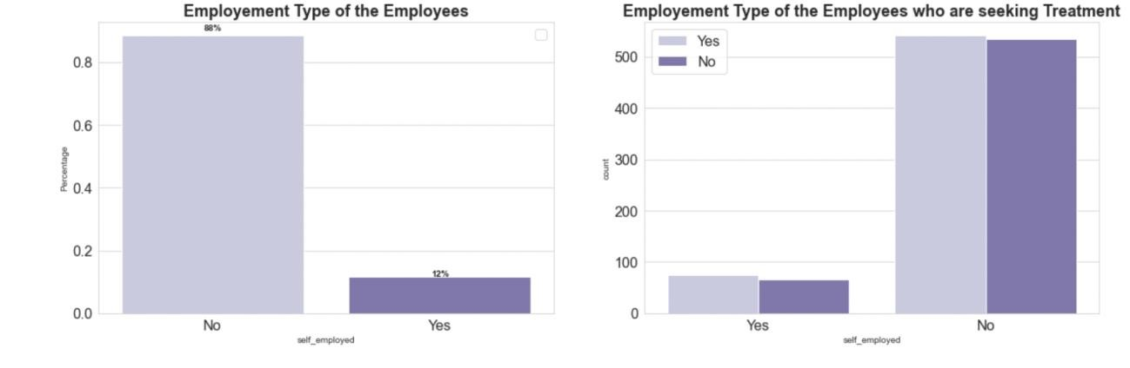
Exploratory Data Analysis :

Slide 14
Tools to be TOOLS THAT WE USED USED
JUPYTER : We use jupyter to load our dataset , train and test the data using machine learning algorithms to predict the accuracy.
Numpy, Scikit-Learn, Pandas, Matplotlib,
AWS : We use AWS for hosting the web application into a flask server.

Slide 15





Tools Used:
REPOSITORIES:
GitHub
PROGRAMMING LANGUAGE :
Python
PROGRAMMING:
Jupyter notebook
CLOUD STORAGE:
Amazon Web Services (AWS)
Microsoft Azure
DATABASE :
SQL database (MySQL)

Slide 16
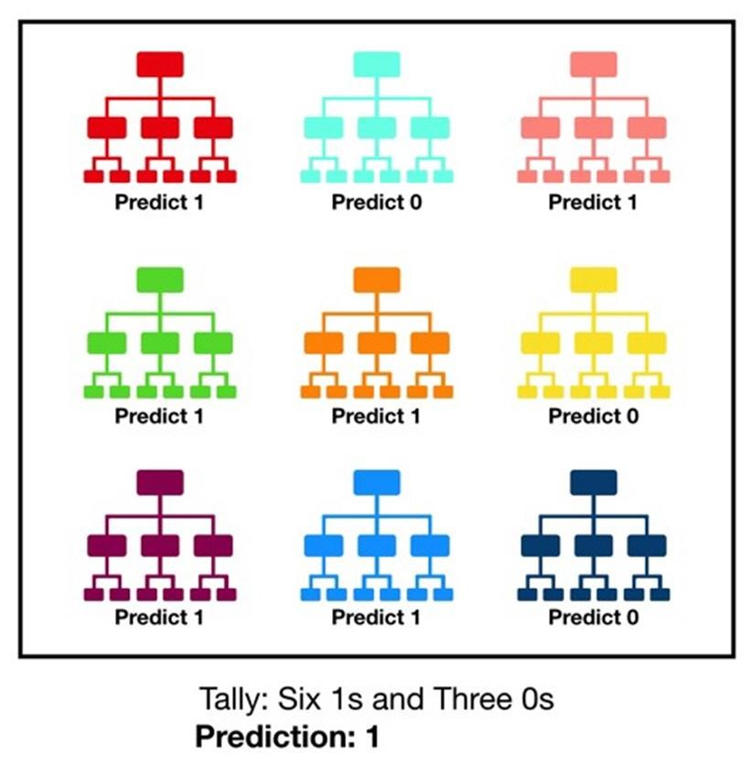
Models that have been used to solve this problem :
We have used Random Forest Classifier,Gradient Boost and AdaBoost Classifier as they give higher accuracy than other models since they are combinations of different models.

Slide 17
The Random Forest Classifier :
Like its name suggests, a random forest is made up of numerous independent decision trees that work together as an ensemble.
Every every tree in the random forest spits out a class forecast, and the classification that receives the most votes becomes the prediction made by our model .
Ada Boost :
A highly well-liked boosting technique called AdaBoost (Adaptive Boosting) seeks to combine several weak classifiers into one powerful classifier. Yoav Freund and Robert Schapire wrote the first AdaBoost paper.
A single classifier might not be able to predict an object's class with sufficient accuracy, but by grouping several weak classifiers and having each one gradually learn from the incorrectly classified items of the others, we can create one such strong model.
The classifier given here could be any of your standard classifiers, including Logistic Regression, Decision Trees (which are frequently the default), and others.

Slide 18
The entire process uses a data engineering pipeline to guarantee flawless execution.
To make sure the appropriate set of data is gathered for the problem statement, the five Vs of data are examined.
Data preprocessing is conducted to eliminate any noise, bias, or outliers present in the dataset.
For the Machine Learning model to comprehend, feature extraction is used to convert non-numeric and categorical variables.
The dataset is used to create Random Forest Regression and Linear Regression models.
Accuracy and error calculations are used to assess models.
Models are implemented effectively.

Slide 19

Conclusion
By using flask we created an application which predicts whether an employee needs to take treatment or not
The final conclusions of the project should be tailored to the specific context and needs of the organization, with a focus on actionable insights that can drive positive change and promote a healthier, more supportive work environment.

Slide 20

References
https://www.kaggle.com/code/aditimulye/mental-health-at-workplace
https://github.com/VDUGG2/DIistributed

Slide 21


